Slide 1

Performance Efficient Scheduling in Dynamic Cores
Mid-Sem Presentation
Presented by:
Hatim Shakir (B200830CS),
Arif Raza Mansuri (B200808CS), Anagha M V (B200762CS)
Guided & Supervised by:
Dr. Nirmal Kumar Boran,
Department of Computer Science & Engineering

Slide 2
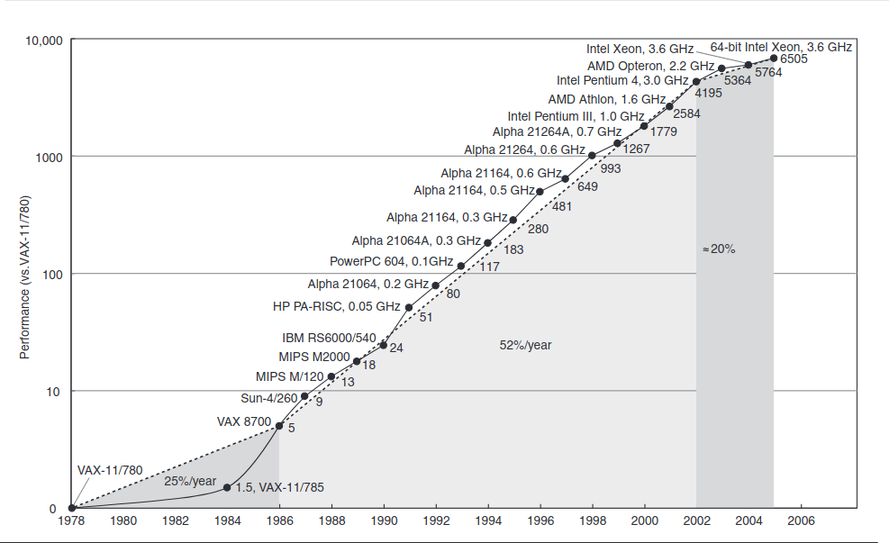
Brief History
References:
Computer Architecture: A Quantitative Approach, David A Patterson and John L. Hennessy, 5th Edition

Slide 3
Processor’s Evolution
Performance:
Architectural innovations
Technology advancements
Power dissipation
The faster the better
High Performance
Power dissipation became the bottleneck
Ref: Computer Architecture: A Quantitative Approach, David A Patterson and John L. Hennessy, 5th Edition
Slide has been taken from:PhD Defence Presentation, Nirmal Kumar Boran

Slide 4
Processor’s Evolution
Multi-Core
More the better
System Throughput
Single Thread Program
Energy Efficiency
Hardware Security
Ref: Computer Architecture: A Quantitative Approach, David A Patterson and John L. Hennessy, 5th Edition
Slide has been taken from:PhD Defence Presentation, Nirmal Kumar Boran

Slide 5
Performance Enhancement
Single thread performance is bottleneck
Slide has been taken from:PhD Defence Presentation, Nirmal Kumar Boran

Slide 6
Performance Enhancement
Single thread performance is bottleneck
ISA can help ?
Slide has been taken from:PhD Defence Presentation, Nirmal Kumar Boran

Slide 7
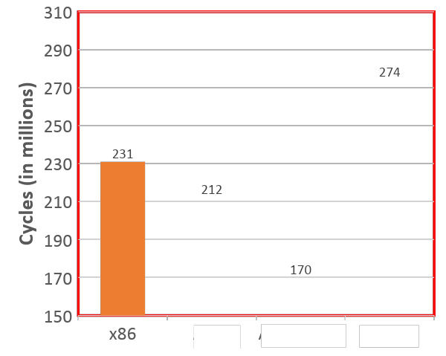
Performance Enhancement
Single thread performance is bottleneck
ISA can help ?
x86
x86
L1 Cache
L1 Cache
Shared Cache
Main Memory
Slide has been taken from:PhD Defence Presentation, Nirmal Kumar Boran

Slide 8
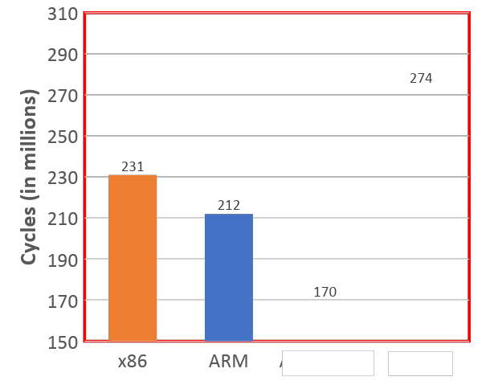
Performance Enhancement
Single thread performance is bottleneck
ISA can help ?
ARM
ARM
L1 Cache
L1 Cache
Shared Cache
Main Memory
Slide has been taken from:PhD Defence Presentation, Nirmal Kumar Boran

Slide 9
Performance Enhancement
Single thread performance is bottleneck
Yes, ISA helps. Is ARM always the better choice?
ARM
ARM
L1 Cache
L1 Cache
Shared Cache
Main Memory
Slide has been taken from:PhD Defence Presentation, Nirmal Kumar Boran

Slide 10
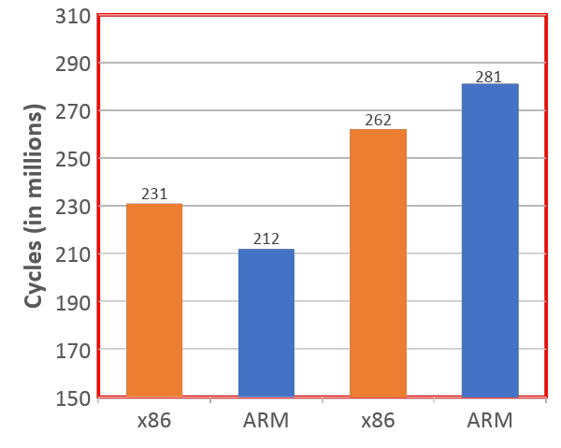
Performance Enhancement
Single thread performance is bottleneck
Yes, ISA helps. But only in ARM ?
ARM
ARM
L1 Cache
L1 Cache
Program 2
Program 1
Shared Cache
Main Memory
Slide has been taken from:PhD Defence Presentation, Nirmal Kumar Boran

Slide 11
Performance Enhancement
Single thread performance is bottleneck
Yes, ISA helps. But only in ARM ?
x86
ARM
L1 Cache
L1 Cache
Program 2
Single threaded programs🡪
Program 1: ARM
Program 2: x86
Program 1
Shared Cache
Main Memory
Slide has been taken from:PhD Defence Presentation, Nirmal Kumar Boran

Slide 12
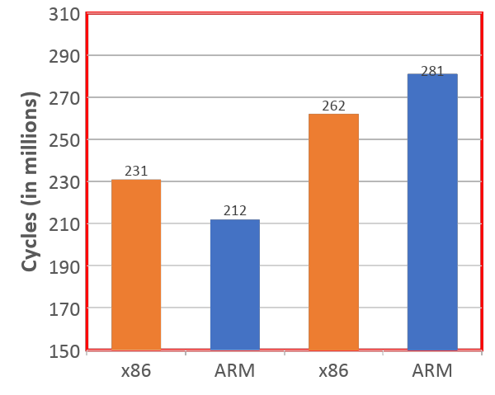
Performance Enhancement
ISA can help in single threaded program’s performance improvement
x86
ARM
L1 Cache
L1 Cache
Program 2
Single threaded programs🡪
Program 1: ARM
Program 2: x86
Program 1
Shared Cache
Main Memory
Slide has been taken from:PhD Defence Presentation, Nirmal Kumar Boran

Slide 13
01 : Harnessing ISA Diversity
Venkat, A. and Tullsen, D.M., 2014. Harnessing ISA diversity: Design of a heterogeneous-ISA chip multiprocessor. ACM SIGARCH Computer Architecture News, 42(3), pp.121-132.

Slide 14
Motivation
Choosing multiple-ISAs to exist in a core is a promising avenue for performance gains.
ISA diversity brings characteristic differences in code density, decode and instruction complexity, register pressure, native-floating point arithmetic vs Emulation, and SIMD processing
Design of such a Heterogeneous ISA Chip Multiprocessor is a complex task due to large search space and billions of combinations.
References:

Slide 15
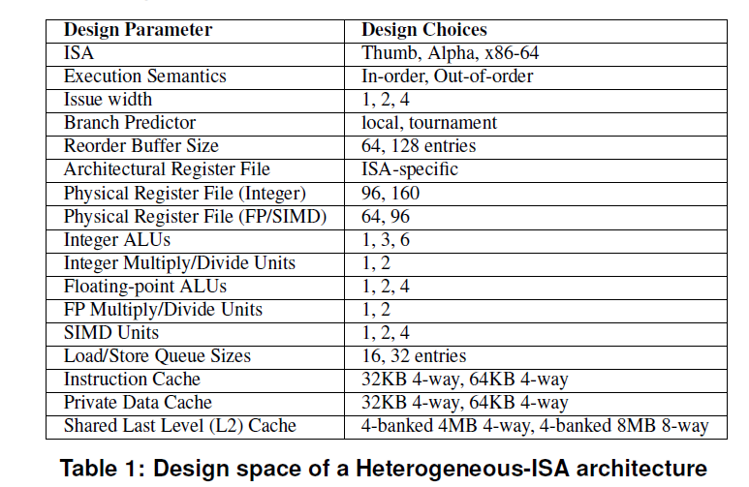
Methodology
References:
Venkat, A. and Tullsen, D.M., 2014. Harnessing ISA diversity: Design of a heterogeneous-ISA chip multiprocessor. ACM SIGARCH Computer Architecture News, 42(3), pp.121-132.

Slide 16
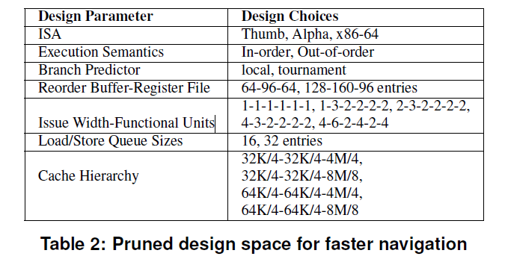
Methodology
References:
Venkat, A. and Tullsen, D.M., 2014. Harnessing ISA diversity: Design of a heterogeneous-ISA chip multiprocessor. ACM SIGARCH Computer Architecture News, 42(3), pp.121-132.

Slide 17
Motivation (cont.)
ISA Heterogeneity is beneficial:
Across multiple different application programs
Across multiple phases of the same programs
Migration across ISAs is a well-known hard problem.[1]
References:
DeVuyst, M., Venkat, A. and Tullsen, D.M., 2012, March. Execution migration in a heterogeneous-ISA chip multiprocessor. In Proceedings of the seventeenth international conference on Architectural Support for Programming Languages and Operating Systems (pp. 261-272).

Slide 18
Methodology
Target ISAs are selected a priori – and adding more ISAs will only push the performance improvement even further
Discussion of some axes of heterogeneity among ISAs:
Code Density
Dynamic Instruction
Register Pressure
Floating Point and SIMD Support
References:

Slide 19
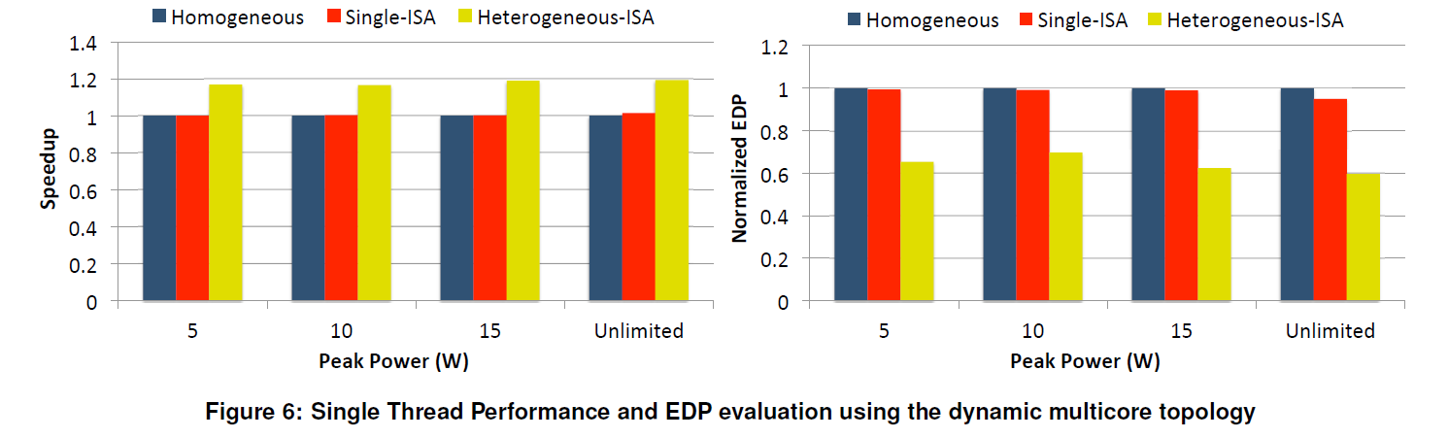
Results
References:
Venkat, A. and Tullsen, D.M., 2014. Harnessing ISA diversity: Design of a heterogeneous-ISA chip multiprocessor. ACM SIGARCH Computer Architecture News, 42(3), pp.121-132.

Slide 20
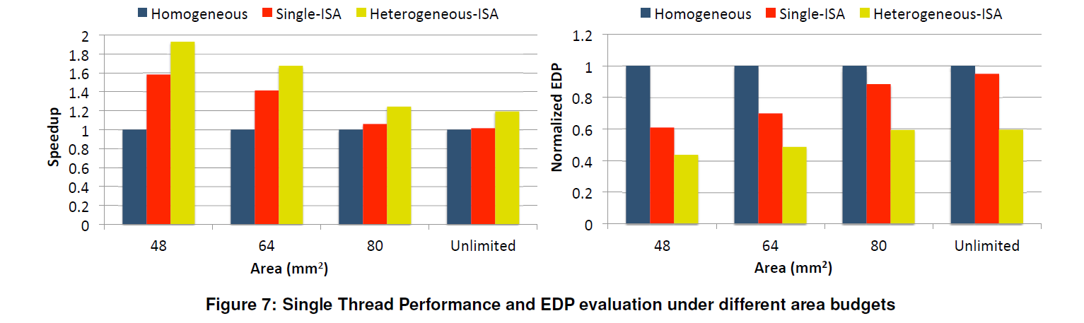
Results
References:
Venkat, A. and Tullsen, D.M., 2014. Harnessing ISA diversity: Design of a heterogeneous-ISA chip multiprocessor. ACM SIGARCH Computer Architecture News, 42(3), pp.121-132.

Slide 21
Results
Additional speedup of 11.2% due to migration alone on a heterogeneous-ISA CMP, in contrast to the 4.6% speedup due to migration on a single-ISA heterogeneous CMP
Heterogeneous-ISA CMPs achieve an average energy savings of 21.5% and an average reduction of 27.8% in the EDP over single-ISA heterogeneous CMPs, with absolutely no loss in performance
References:
Venkat, A. and Tullsen, D.M., 2014. Harnessing ISA diversity: Design of a heterogeneous-ISA chip multiprocessor. ACM SIGARCH Computer Architecture News, 42(3), pp.121-132.

Slide 22
Results
We find that heterogeneous-ISA CMPs can provide 15.8% better throughput on multi-programmed workloads than the best single-ISA heterogeneous CMPs.
In a highly peak power constrained environment,the heterogeneous-ISA CMP still manages to achieve a speedup of 16.9% over a single-ISA heterogeneous CMP.
References:
Venkat, A. and Tullsen, D.M., 2014. Harnessing ISA diversity: Design of a heterogeneous-ISA chip multiprocessor. ACM SIGARCH Computer Architecture News, 42(3), pp.121-132.

Slide 23
02 : Execution Migration
DeVuyst, M., Venkat, A. and Tullsen, D.M., 2012, March. Execution migration in a heterogeneous-ISA chip multiprocessor. In Proceedings of the seventeenth international conference on Architectural Support for Programming Languages and Operating Systems (pp. 261-272).

Slide 24
Motivation
Research shows the evidence for higher performance and energy efficiency in Heterogeneous ISA CMP.
This requires efficient migration across ISAs.
It can be achieved by as little transformation of program state as possible.
Thus, is achieved by making program state consistent at several points throughout execution called EQUIVALENCE POINTS.
References:

Slide 25
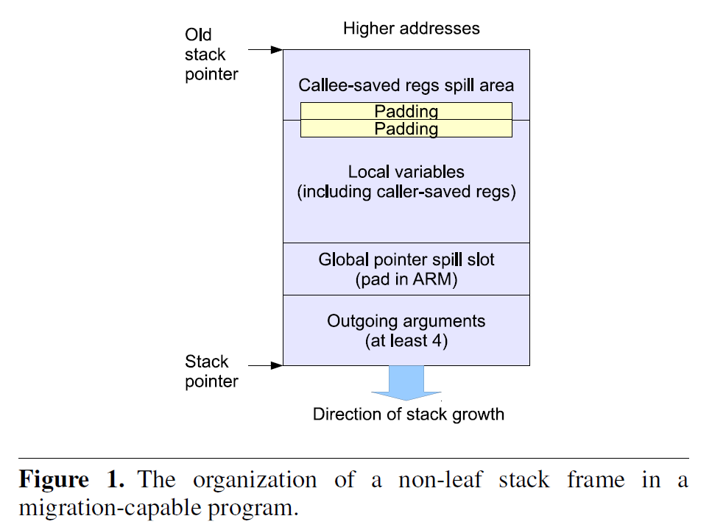
Methodologies
Assumptions:
Same endianness for all ISAs
Same fundamental datasize
Memory Image Consistency
Global Data Consistency
Code Section Consistency
Heap Consistency
Stack Consistency
i. Function Arguments
ii. Caller vs Callee Saved Spill Locations
iii. Local Variables
References:
DeVuyst, M., Venkat, A. and Tullsen, D.M., 2012, March. Execution migration in a heterogeneous-ISA chip multiprocessor. In Proceedings of the seventeenth international conference on Architectural Support for Programming Languages and Operating Systems (pp. 261-272).

Slide 26
Methodologies
Due to imposing all above consistency mechanisms, the program state becomes consistent across ISAs for several points in the code
All these points are function call sites, and also called Equivalence Points.
Migration can be done very efficiently at these equivalence points.
References:

Slide 27
Methodologies
Stack Transformer: paper proposes a two-pass mechanism
The first-pass goes from innermost frame to outermost frame
It collects information about the live registers across call sites and collects the values
It also collects values of caller-saved registers
It updates the the return addresses
The second-pass goes in the reverse direction, and updates the the register state at each call site using the values collected in first-pass
References:

Slide 28
Methodologies
Binary Translation: used to offer instantaneous migration capabilities
Follows a JIT (just in time) scheme
References:

Slide 29
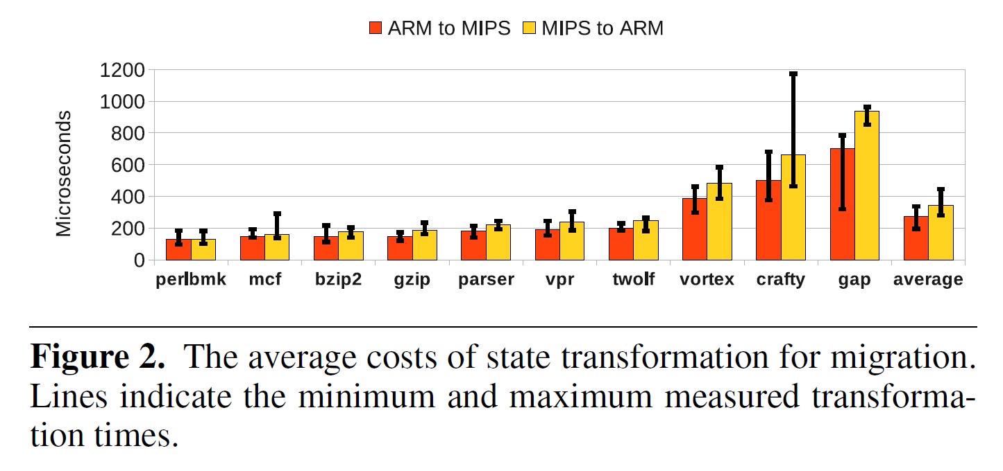
Results
References:
DeVuyst, M., Venkat, A. and Tullsen, D.M., 2012, March. Execution migration in a heterogeneous-ISA chip multiprocessor. In Proceedings of the seventeenth international conference on Architectural Support for Programming Languages and Operating Systems (pp. 261-272).

Slide 30
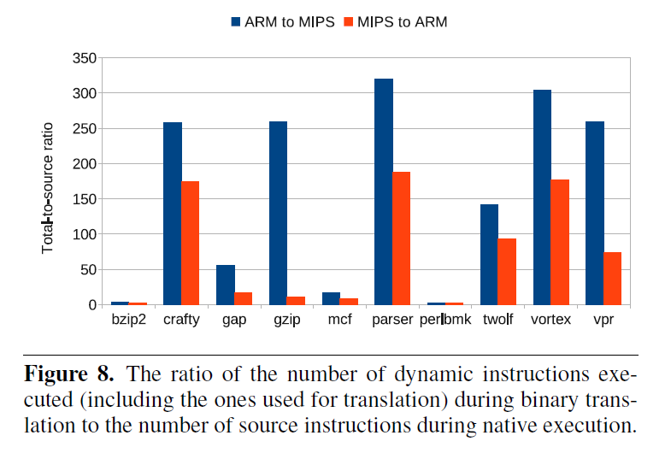
Results
References:
DeVuyst, M., Venkat, A. and Tullsen, D.M., 2012, March. Execution migration in a heterogeneous-ISA chip multiprocessor. In Proceedings of the seventeenth international conference on Architectural Support for Programming Languages and Operating Systems (pp. 261-272).

Slide 31
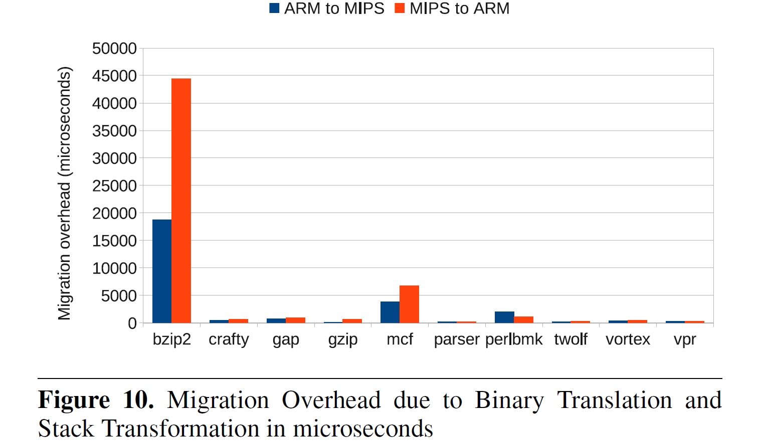
Results
References:
DeVuyst, M., Venkat, A. and Tullsen, D.M., 2012, March. Execution migration in a heterogeneous-ISA chip multiprocessor. In Proceedings of the seventeenth international conference on Architectural Support for Programming Languages and Operating Systems (pp. 261-272).

Slide 32
Results
Even if migration happens every few hundred milliseconds, the total loss in performance is well under 5%.
The paper shows the limitations of very large, coarse-grained scheduling as well as very small, fine-grained scheduling
If the grain-size is too large, heterogeneity is lost
If the grain-size is too fine, migration overhead increases significantly
References:

Slide 33
03 : Composite Cores
Lukefahr, A., Padmanabha, S., Das, R., Sleiman, F.M., Dreslinski, R., Wenisch, T.F. and Mahlke, S., 2012, December. Composite cores: Pushing heterogeneity into a core. In 2012 45th annual IEEE/ACM international symposium on microarchitecture (pp. 317-328). IEEE.

Slide 34
Motivation
To build an architecture that reduces switching overheads by bringing the notion of heterogeneity within a single core.
HERE, WE ARE INTRODUCING the concept of composite cores, that can also promise you the energy savings.
To get an idea about the composite cores we have taken the reference of the research paper named “Composite cores – pushing heterogeneity into a core issued by Andrew lukefahr and his team” .
The team was able to concluded with a result of 18% of energy savings and 5% of performances loss
References:
Lukefahr, A., Padmanabha, S., Das, R., Sleiman, F.M., Dreslinski, R., Wenisch, T.F. and Mahlke, S., 2012, December. Composite cores: Pushing heterogeneity into a core. In 2012 45th annual IEEE/ACM international symposium on microarchitecture (pp. 317-328). IEEE.

Slide 35
Key Insights
The key insight from the research paper is that composite cores can achieve higher performance and energy efficiency than homogeneous cores by leveraging heterogeneity to better match the workload characteristics.
Due to the switching overhead migration opportunities are limited to coarse-grained phases(100 Million Instructions) reducing the potential to exploit energy efficient cores.
In coarse-granularity the low performance phase do exit but very infrequent and hence limiting the potential to utilize a more efficient core.
References
Lukefahr, A., Padmanabha, S., Das, R., Sleiman, F.M., Dreslinski, R., Wenisch, T.F. and Mahlke, S., 2012, December. Composite cores: Pushing heterogeneity into a core. In 2012 45th annual IEEE/ACM international symposium on microarchitecture (pp. 317-328). IEEE.:

Slide 36
Approach
They have proposed an idea of Composite Cores, an architecture that reduces switching overheads by bringing the notion of heterogeneity within a single core.
They have studied the benefits of fine-grained switching in the context of heterogeneous core architectures. To achieve near zero μEngine transfer overhead, They propose low-overhead switching techniques and a core microarchitecture which shares necessary hardware resources.
They designed an intelligent switching decision logic that facilitates finegrain switching via predictive rather than sampling-based performance estimation.which tightly constrains performance loss within a user-selected bound through a simple feedback controller.
Finally , they evaluate our proposed Composite Core architecture with cycle accurate full system simulations and integrated power models. Overall, a Composite Core can map an average of 25% of the dynamic execution to the little μEngine and reduce energy by 18% while bounding performance degradation to at most 5%.

Slide 37
04 : Performance Modelling & Dynamic Scheduling
Boran, N.K., Yadav, D.K. and Iyer, R., 2019. Performance modelling and dynamic scheduling on heterogeneous-ISA multi-core architectures. In VLSI Design and Test: 23rd International Symposium, VDAT 2019, Indore, India, July 4–6, 2019, Revised Selected Papers 23 (pp. 702-715). Springer Singapore.

Slide 38
Background
Venkat et al.[1] made significant contributions to single-threaded program performance, power efficiency, and the energy-delay product through the introduction of ISA heterogeneity.
Their research divided programs into multiple phases, each comprising 100 million dynamic instructions.
Their work revealed that each phase exhibited a strong affinity towards a specific ISA.
References:
Venkat, A. and Tullsen, D.M., 2014. Harnessing ISA diversity: Design of a heterogeneous-ISA chip multiprocessor. ACM SIGARCH Computer Architecture News, 42(3), pp.121-132.

Slide 39
Background
Factors influencing this affinity included code density, dynamic instruction count, and register pressure.
By executing each phase on its most affined ISA, substantial speedups were achieved, surpassing the performance when running all phases on a single ISA.
References:

Slide 40
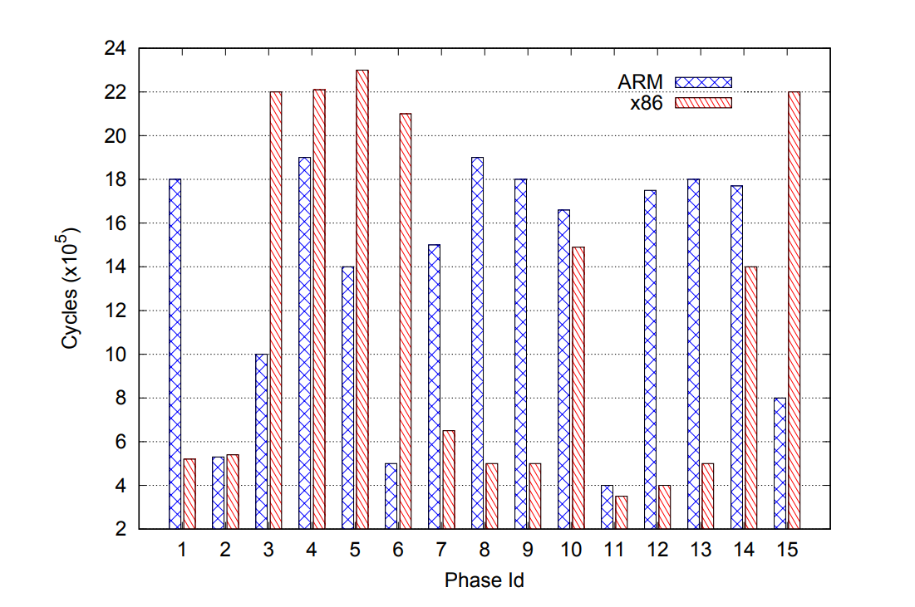
Motivation
Execution time of different phases of benchmark astar
References:
Boran, N.K., Yadav, D.K. and Iyer, R., 2019. Performance modelling and dynamic scheduling on heterogeneous-ISA multi-core architectures. In VLSI Design and Test: 23rd International Symposium, VDAT 2019, Indore, India, July 4–6, 2019, Revised Selected Papers 23 (pp. 702-715). Springer Singapore.

Slide 41
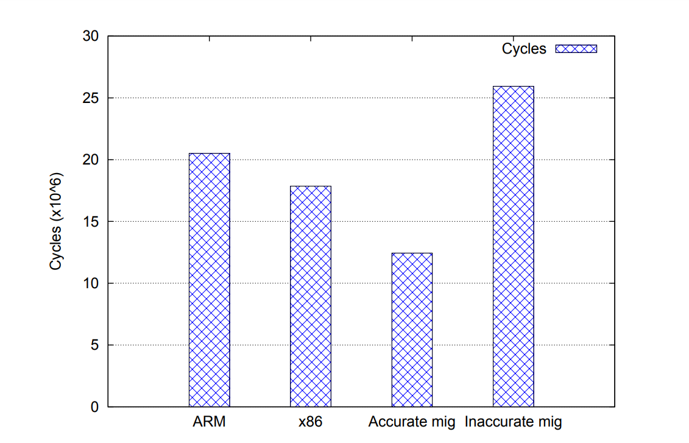
Motivation
References:
Boran, N.K., Yadav, D.K. and Iyer, R., 2019. Performance modelling and dynamic scheduling on heterogeneous-ISA multi-core architectures. In VLSI Design and Test: 23rd International Symposium, VDAT 2019, Indore, India, July 4–6, 2019, Revised Selected Papers 23 (pp. 702-715). Springer Singapore.

Slide 42
Motivation
To bridge the gap between the prospective gains of Heterogeneous ISA Multicore Architecture (HeIMC) and on how to achieve them.
Venkat et al.[1] do not address this issue at all, assuming the existence of a prediction oracle which makes perfect decisions.
The upper bound for the performance increase is 39% (without migration overhead) but is it’s done in-accurately it can deteriorate the performance by 26% [2].
References:
Venkat, A. and Tullsen, D.M., 2014. Harnessing ISA diversity: Design of a heterogeneous-ISA chip multiprocessor. ACM SIGARCH Computer Architecture News, 42(3), pp.121-132.
Boran, N.K., Yadav, D.K. and Iyer, R., 2019. Performance modelling and dynamic scheduling on heterogeneous-ISA multi-core architectures. In VLSI Design and Test: 23rd International Symposium, VDAT 2019, Indore, India, July 4–6, 2019, Revised Selected Papers 23 (pp. 702-715). Springer Singapore.

Slide 43
Prior Work
First work was by Kumar et al.[1] in his 2003 paper Single-ISA heterogeneous multi-core architectures who used a sampling base technique.It’s limitations :
Poor resource utilization.
Does not scale with increasing core count.
Later some regression based model using ILP and MLP were used for estimating migration while this worked well for HeMC.Its limitation
Not designed to take into account factors that determine performance variation across ISAs
For example code density, register pressure and instruction mix etc.
References:
Rakesh Kumar, Keith I Farkas, Norman P Jouppi, Parthasarathy Ranganathan, and Dean M Tullsen. Single-isa heterogeneous multi-core architectures: The potential for processor power reduction. In Proceedings. 36th Annual IEEE/ACM International Symposium on Microarchitecture, 2003. MICRO-36., pages 81–92. IEEE, 2003.
Boran, N.K., Yadav, D.K. and Iyer, R., 2019. Performance modelling and dynamic scheduling on heterogeneous-ISA multi-core architectures. In VLSI Design and Test: 23rd International Symposium, VDAT 2019, Indore, India, July 4–6, 2019, Revised Selected Papers 23 (pp. 702-715). Springer Singapore.

Slide 44
Methodology
Goal : To devise a model that takes in account the micro-architectural and ISA specific parameters.
13 parameters were used for the execution time prediction. After that the time is fed into a scheduler then greedly selects the best ISA for the next phase.
The parameters include branch miss-predictions, L1-I-cache misses, L1-D-cache misses,L2 cache misses, Reorder Buffer full events, Instruction Queue full events, Store Queue full events, ILP, MLP, MSHR full events,instruction mix and the dynamic instruction count.
References:
Boran, N.K., Yadav, D.K. and Iyer, R., 2019. Performance modelling and dynamic scheduling on heterogeneous-ISA multi-core architectures. In VLSI Design and Test: 23rd International Symposium, VDAT 2019, Indore, India, July 4–6, 2019, Revised Selected Papers 23 (pp. 702-715). Springer Singapore.

Slide 45
Scheduler
Challenge:
This division of the program into phases poses a significant challenge for the scheduler.
Ideally ,the first few (10-20M) instructions of the phase should be used predict which ISA it is suited to.
Since migration can only occur at the equivalence points.
Scheduling decisions must be made before the phase begins to execute.
References:
Ashish Venkat and Dean M Tullsen. Harnessing isa diversity: Design of a heterogeneous-isa chip multiprocessor. ACM SIGARCH Computer Architecture News, 42(3):121–132, 2014.
Matthew DeVuyst, Ashish Venkat, and Dean M Tullsen. Execution migration in a heterogeneous-isa chip multiprocessor. In Proceedings of the seventeenth international conference on Architectural Support for Programming Languages and Operating Systems, pages 261–272, 2012.

Slide 46
Scheduler
Solution:
They took the 10 million instruction from the current running phase and feed to regression-based performance model this works because it is small yet a significant number of instruction and is close to next phase.
Once they got the time for all the ISAs a greedy scheduler was employed.
References:
Boran, N.K., Yadav, D.K. and Iyer, R., 2019. Performance modelling and dynamic scheduling on heterogeneous-ISA multi-core architectures. In VLSI Design and Test: 23rd International Symposium, VDAT 2019, Indore, India, July 4–6, 2019, Revised Selected Papers 23 (pp. 702-715). Springer Singapore.

Slide 47
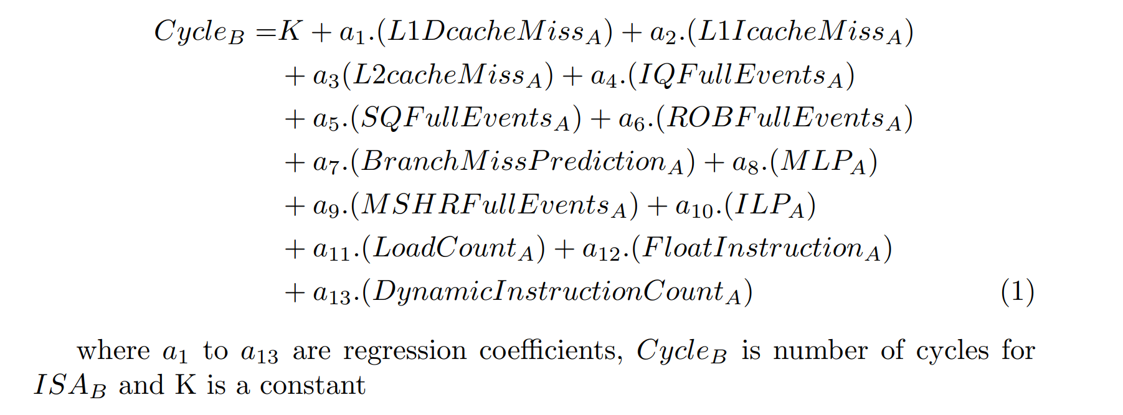
Linear Regression Model
References:
Boran, N.K., Yadav, D.K. and Iyer, R., 2019. Performance modelling and dynamic scheduling on heterogeneous-ISA multi-core architectures. In VLSI Design and Test: 23rd International Symposium, VDAT 2019, Indore, India, July 4–6, 2019, Revised Selected Papers 23 (pp. 702-715). Springer Singapore.

Slide 48
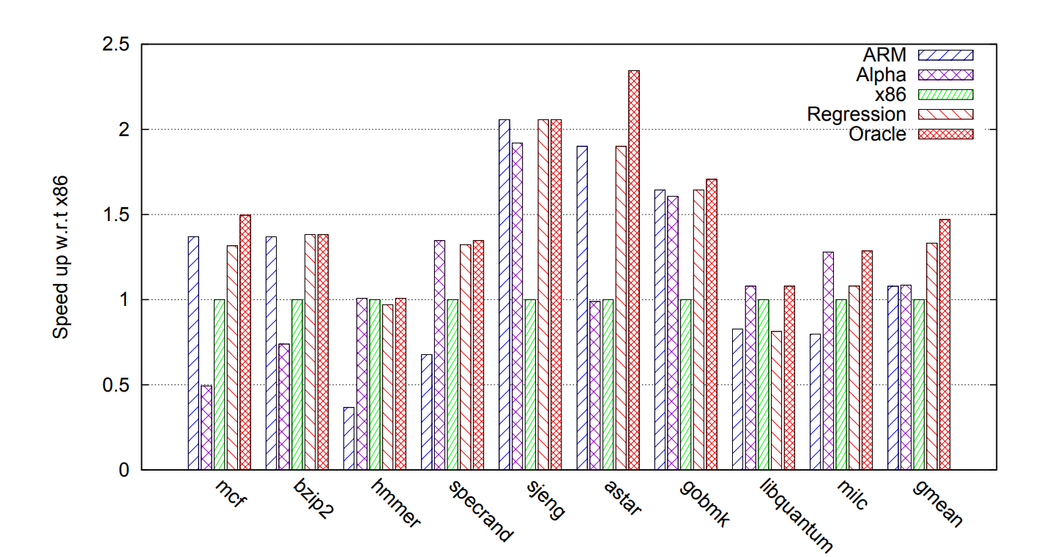
Result
Average speedup of different benchmarks when entire program is scheduled on ARM, Alpha or x86 and compared with HeIMC architecture with regression and oracle based scheduling
References:
Boran, N.K., Yadav, D.K. and Iyer, R., 2019. Performance modelling and dynamic scheduling on heterogeneous-ISA multi-core architectures. In VLSI Design and Test: 23rd International Symposium, VDAT 2019, Indore, India, July 4–6, 2019, Revised Selected Papers 23 (pp. 702-715). Springer Singapore.

Slide 49
05 : Fine-grain Scheduling
Boran, N.K., Rathore, S., Udeshi, M. and Singh, V., 2020. Fine-Grained Scheduling in Heterogeneous-ISA Architectures. IEEE Computer Architecture Letters, 20(1), pp.9-12.

Slide 50
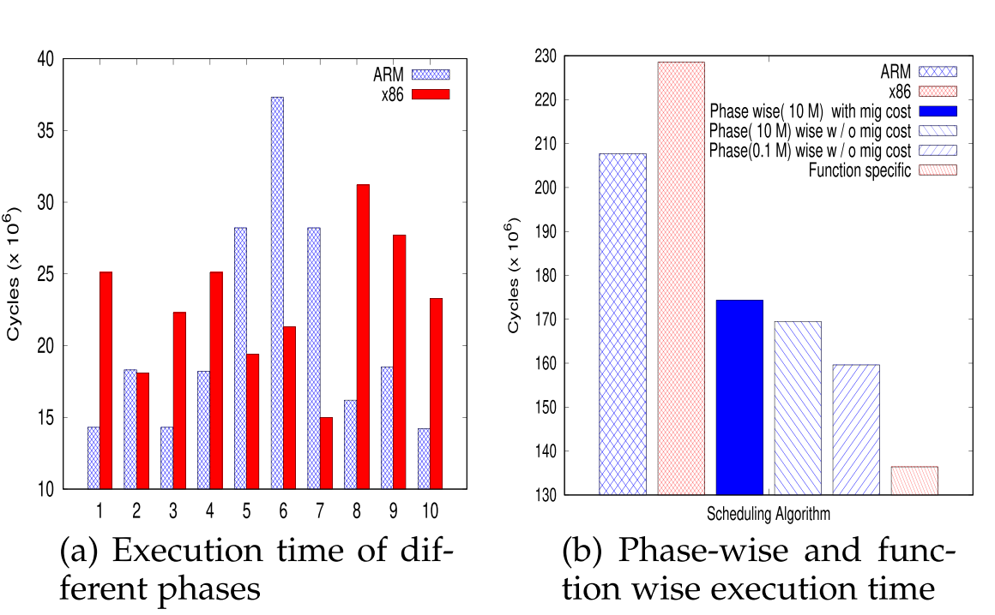
Motivation
References:
Boran, N.K., Rathore, S., Udeshi, M. and Singh, V., 2020. Fine-Grained Scheduling in Heterogeneous-ISA Architectures. IEEE Computer Architecture Letters, 20(1), pp.9-12.

Slide 51
Methodology
To effectively exploit program heterogeneity, Boran et al. introduced a fine-grained function-wise scheduling technique. This approach dynamically scheduled every function to its most affined ISA
Reason for Function Affinity:
code density,dynamic instruction count, register pressure, etc. which varies for each function.
This affinity of a function towards an ISA may only shift by the change in behavior of input data. Hence the need for a dynamic predictor.
Function-wise scheduling not only optimized performance but also minimized migration overhead by transforming only function arguments between ISAs, avoiding complete stack transformations.
References:
Boran, N.K., Rathore, S., Udeshi, M. and Singh, V., 2020. Fine-Grained Scheduling in Heterogeneous-ISA Architectures. IEEE Computer Architecture Letters, 20(1), pp.9-12.

Slide 52
Heuristic Based Approach
It was observed that the affinity do not change too often.
They used a sampling based technique for dynamic prediction.
It was experimentally observed that affinity do not change for approximately 20 consecutive calls.
Execution time is calculated for 19th and 20th call and the Affinity table is updated.
References:
Boran, N.K., Rathore, S., Udeshi, M. and Singh, V., 2020. Fine-Grained Scheduling in Heterogeneous-ISA Architectures. IEEE Computer Architecture Letters, 20(1), pp.9-12.

Slide 53
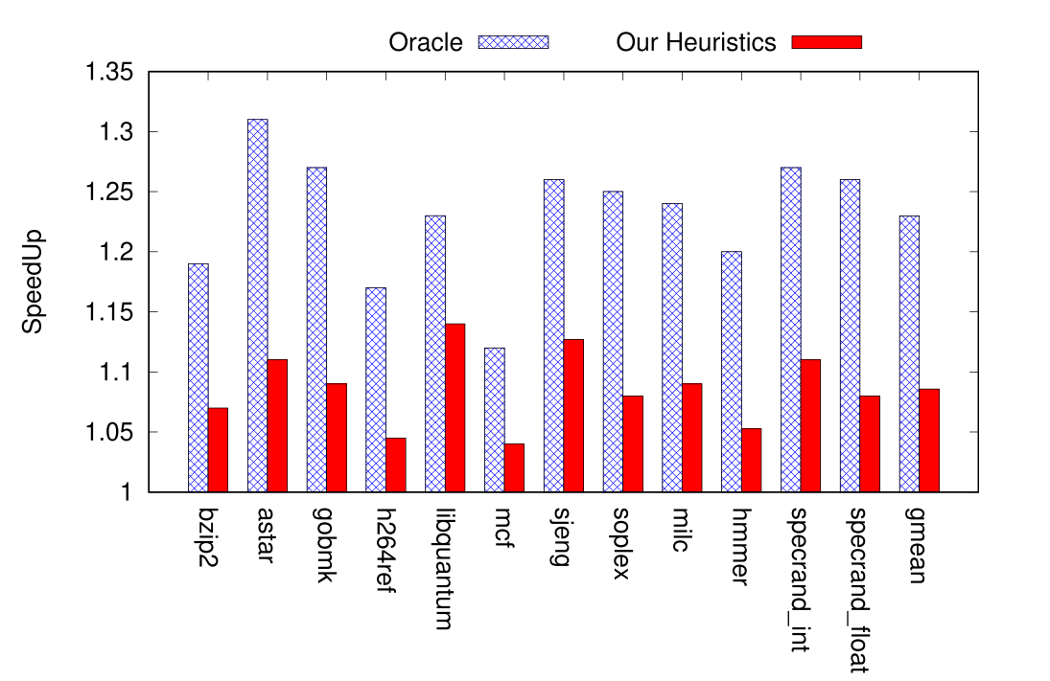
Results..
Speedup of function-wise migration with respect to heterogeneous-ISA architecture
References:
Boran, N.K., Rathore, S., Udeshi, M. and Singh, V., 2020. Fine-Grained Scheduling in Heterogeneous-ISA Architectures. IEEE Computer Architecture Letters, 20(1), pp.9-12.

Slide 54
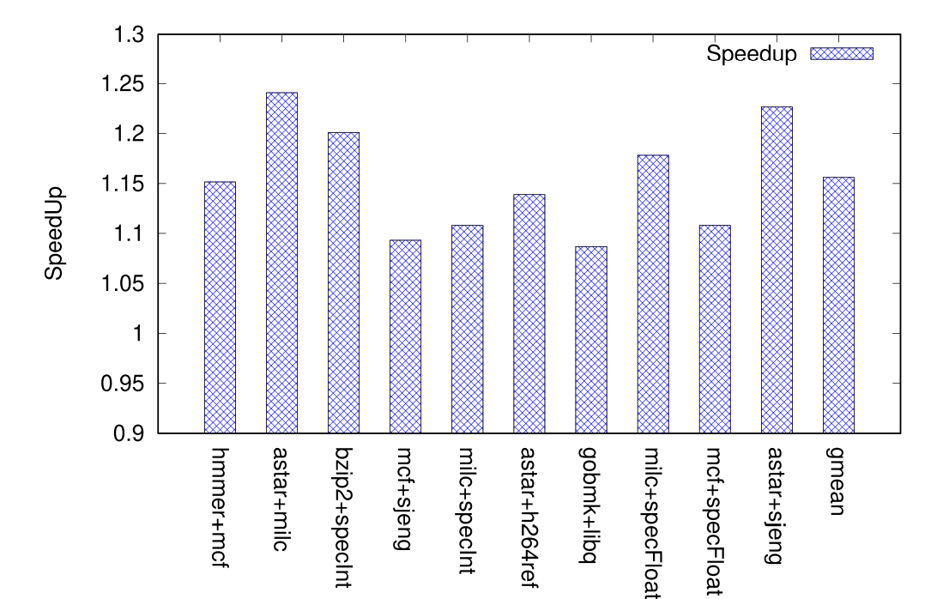
Results..
Speedup of function-wise migration with respect to heterogeneous-ISA architecture for multi-workloads.
References:
Boran, N.K., Rathore, S., Udeshi, M. and Singh, V., 2020. Fine-Grained Scheduling in Heterogeneous-ISA Architectures. IEEE Computer Architecture Letters, 20(1), pp.9-12.

Slide 55
Results
They used GEM5 simulator for running spec 2006 benchmark for X86 and ARM ISA.
Migration : Migration overhead is less, since only a few register values have to be transformed.
Performance :
The proposed approach achieves up to 22.9 percent speedup using oracle based scheduling mechanism
The proposed heuristics technique achieves a speedup of 8.4 percent.
Multi-work load : An average speedup of 15.6 percent is achieved.
References:
Boran, N.K., Rathore, S., Udeshi, M. and Singh, V., 2020. Fine-Grained Scheduling in Heterogeneous-ISA Architectures. IEEE Computer Architecture Letters, 20(1), pp.9-12.

Slide 56
06 : Scheduling in Dynamic Core
Our project, its motivation and proposed methodologies…

Slide 57
Proposal
Bridging the gap between 8% and 23%
The introduction of functional level scheduling by Boran et al. has proved very advantageous due to negligible cross-ISA migration overhead. We aim to exploit this property for our research.
The heuristic technique, as introduced by Boran et al. exhibits an 8.4% speedup only, showing its potential. However, we see an opportunity for further improvement...
References:

Slide 58
Proposal
Another limitation in the technique is that it needs one or two forced migrations every 20 function calls, which is unnecessary overhead. We aim to propose a predictor for the behaviour of the function and take the decision in advance.
References:

Slide 59
Proposal & Methodology
We aim to bridge this gap by more efficient scheduling algorithms based on microarchitectural parameters and run-time statistics, and employing mathematical and machine learning models to predict the most efficient core.
Second goal :
In addition to performance gains, we aim to achieve energy efficiency in the cores through a dynamic scheduling for In-order vs Out-of-order cores, tolerating a threshold performance loss
References:

Slide 60
References
Boran, N.K., Rathore, S., Udeshi, M. and Singh, V., 2020. Fine-Grained Scheduling in Heterogeneous-ISA Architectures. IEEE Computer Architecture Letters, 20(1), pp.9-12.
Venkat, A. and Tullsen, D.M., 2014. Harnessing ISA diversity: Design of a heterogeneous-ISA chip multiprocessor. ACM SIGARCH Computer Architecture News, 42(3), pp.121-132.
DeVuyst, M., Venkat, A. and Tullsen, D.M., 2012, March. Execution migration in a heterogeneous-ISA chip multiprocessor. In Proceedings of the seventeenth international conference on Architectural Support for Programming Languages and Operating Systems (pp. 261-272).
Boran, N.K., Yadav, D.K. and Iyer, R., 2019. Performance modelling and dynamic scheduling on heterogeneous-ISA multi-core architectures. In VLSI Design and Test: 23rd International Symposium, VDAT 2019, Indore, India, July 4–6, 2019, Revised Selected Papers 23 (pp. 702-715). Springer Singapore.

Slide 61
References
5. Lukefahr, A., Padmanabha, S., Das, R., Sleiman, F.M., Dreslinski, R., Wenisch, T.F. and Mahlke, S., 2012, December. Composite cores: Pushing heterogeneity into a core. In 2012 45th annual IEEE/ACM international symposium on microarchitecture (pp. 317-328). IEEE.
6. R. Kumar, K. I. Farkas, N. P. Jouppi, P. Ranganathan, and D. M. Tullsen. Single-ISA Heterogeneous Multi-core Architectures: The Potential for Processor Power Reduction. In International Symposium on Microarchitecture, Dec. 2003.
7. Kumar, R., Tullsen, D.M., Jouppi, N.P. and Ranganathan, P., 2005. Heterogeneous chip multiprocessors. Computer, 38(11), pp.32-38.

Slide 62
Thank you!
Do you have any questions regarding the presentation?

